Slide 1
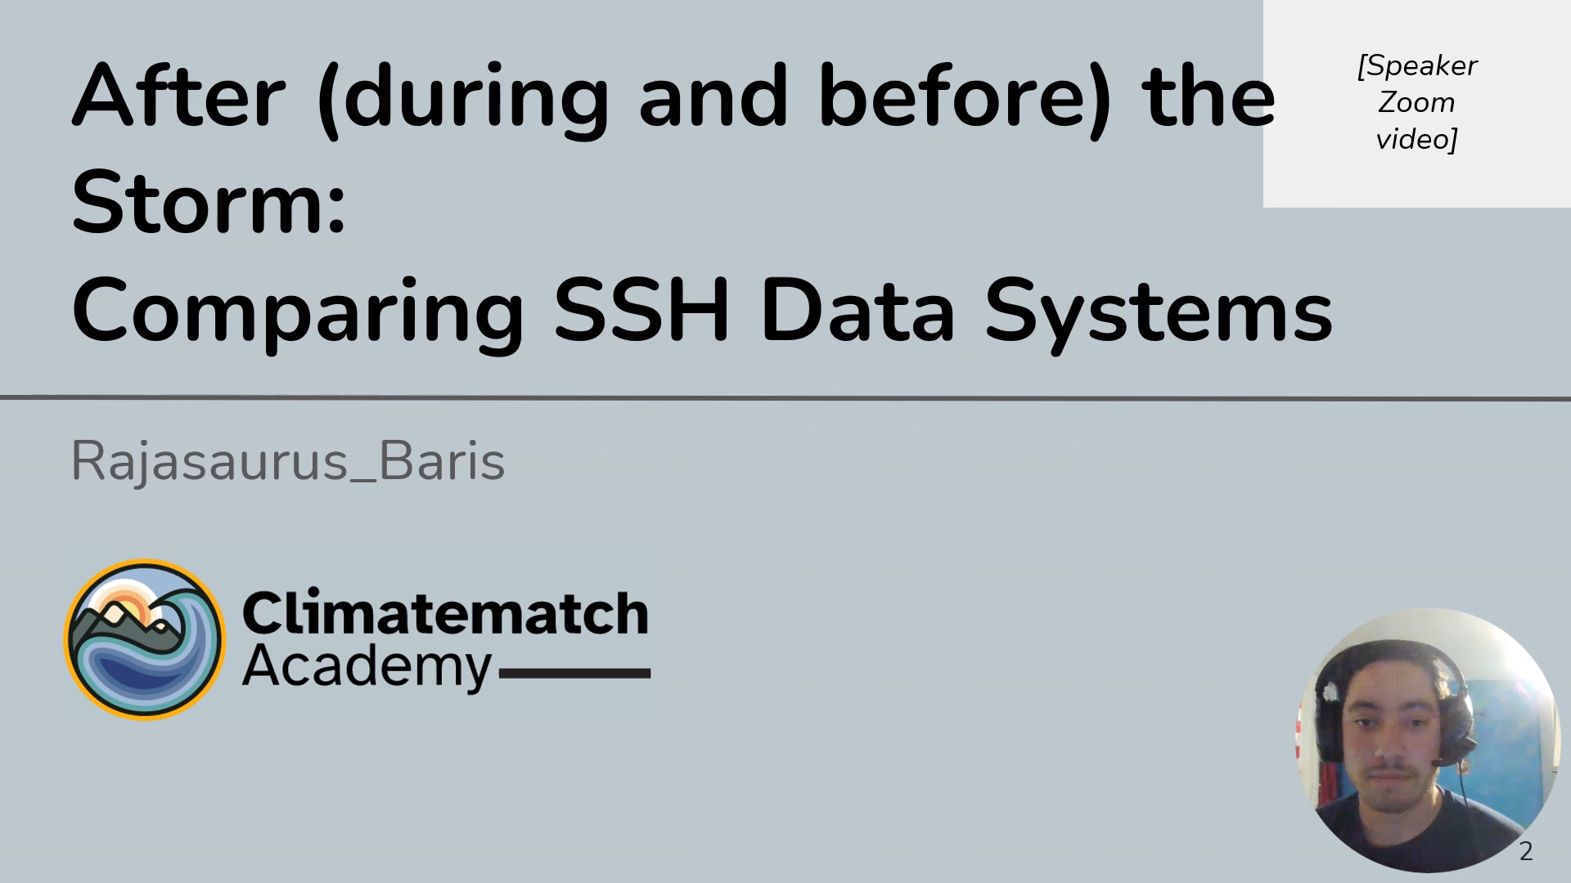

Slide 2
Research Question & Hypothesis
Is there correlation between ECCO data and TG data before, during and after severe storm impact events?
Hypothesis 1: There is a linear relationship between ECCO and TG data during severe storm impact events
Hypothesis 2: There is no linear relationship between ECCO data and TG data during severe storm impact events
STEPS:
Identify current network of TGs in our regions of interest (ROI)
Compare ECCO and TG data recorded:
one month of data, one month prior to the beginning of extreme weather events
during the extreme weather events
one month of data, one month after the end of the extreme weather events
Determine the correlation/linear relationship between the ECCO and TG data
Notes:
FAITH

Slide 3
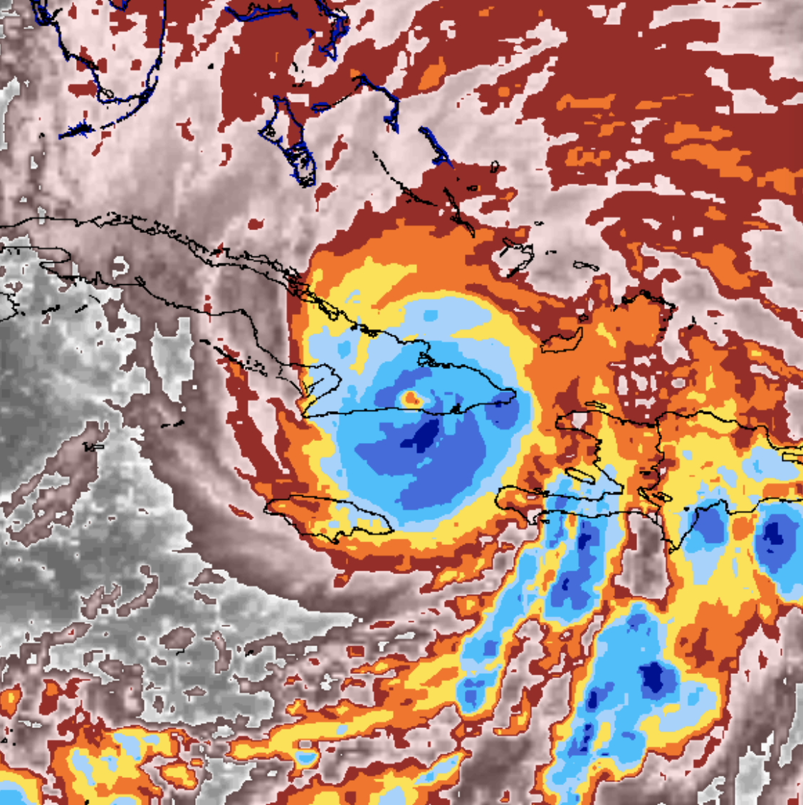
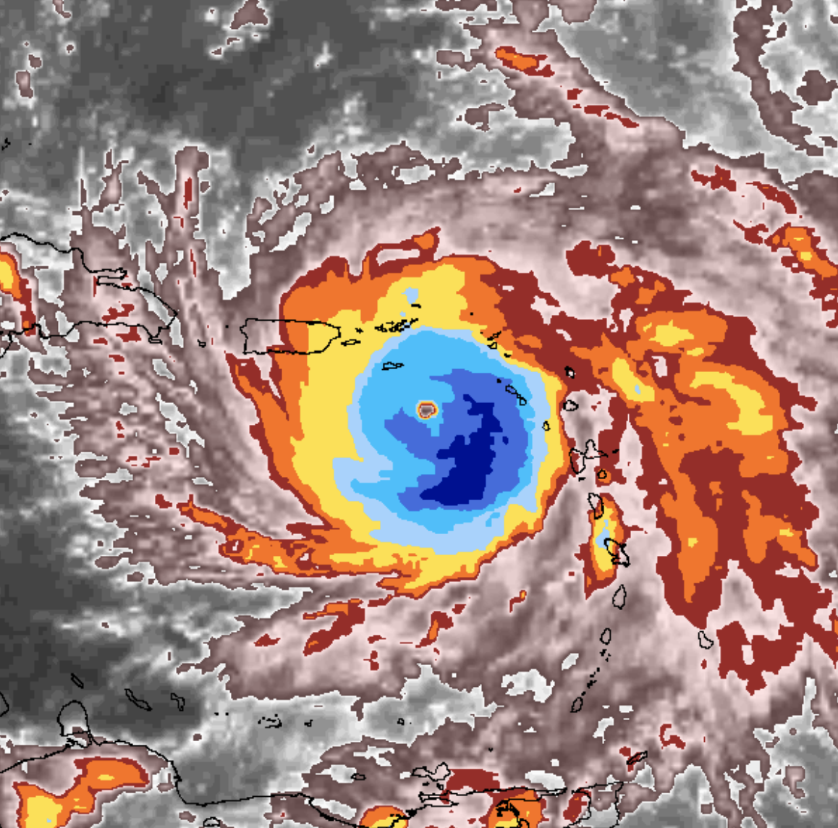
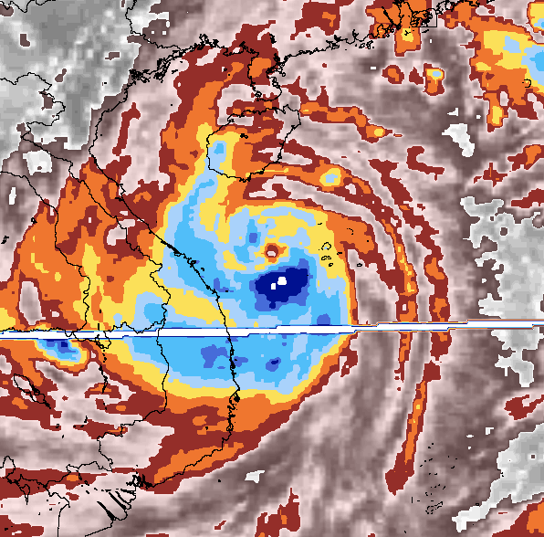
Selected Storms
Hurricane Sandy
New Jersey
Full Moon-Spring Tide
Landfall 30/10/2012 00Z
Hurricane Maria, PR and Caribbean
New Moon-Spring Tide
Landfall 20/9/2017 10Z
Typhoon Ketsana, Philippines and Vietnam
Half moon waxing-Neap Tide
Landfall 26/09/2009, 29/09/2009
Satellite imagery near maximum intensity of Hurricane Sandy, Maria, and Typhoon Ketsana
from Knapp, K. R., H. J. Diamond, J. P. Kossin, M. C. Kruk, C. J. Schreck, 2018: International Best Track Archive for Climate Stewardship (IBTrACS) Project, Version 4. [2012296N14283]. NOAA National Centers for Environmental Information. doi:10.25921/82ty-9e16 [27/7/2023]
Notes:
AIZAT:
Sandy Category 3 at the time of landfall
Max Intensity 100 kt (Oct 25 05Z), 940 mb (Oct 29 18Z), Total Duration 11 (days)
Maria category 5 at the time of landfall
Max intensity 150 kt (Sep 20 00Z), 908 mb (Sep 20 03Z)
Typhoon Ketsana
90 kt (Sep 28 12Z), 955 mb (Sep 28 18Z)

Slide 4
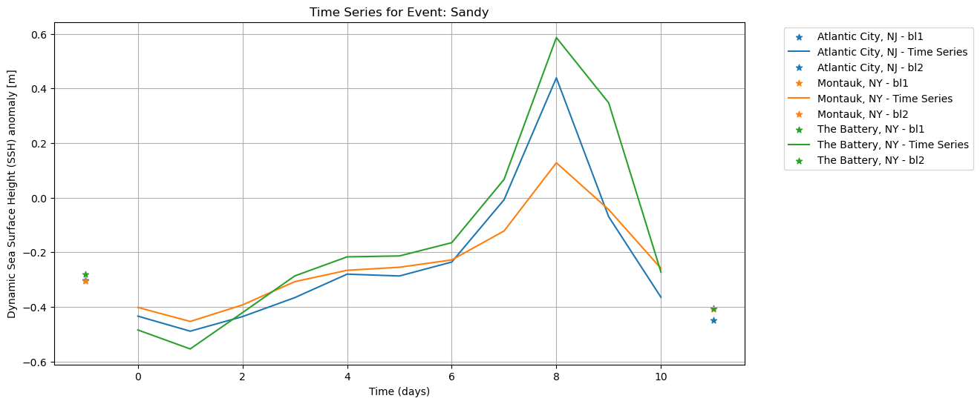
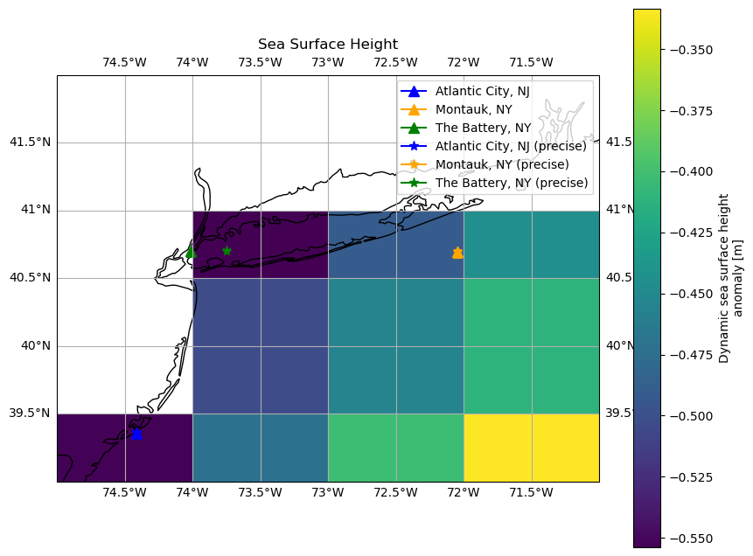
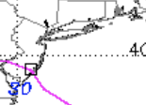
Hurricane Sandy
Notes:
AYMAN

Slide 5
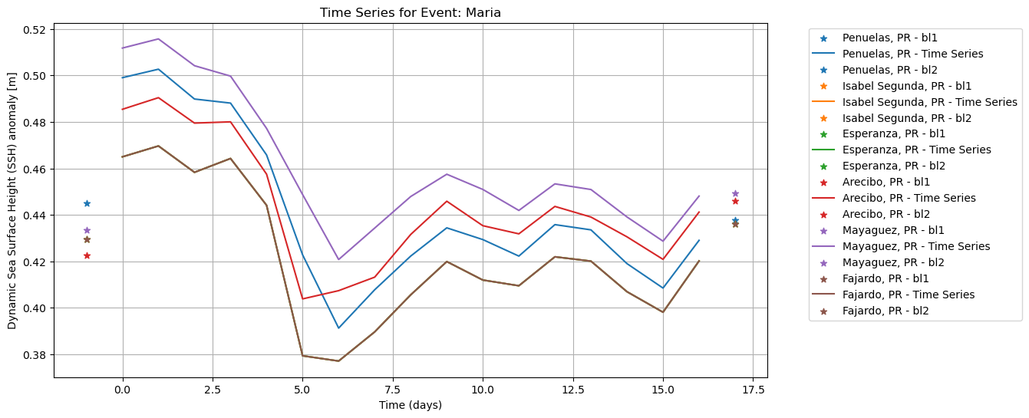
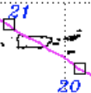
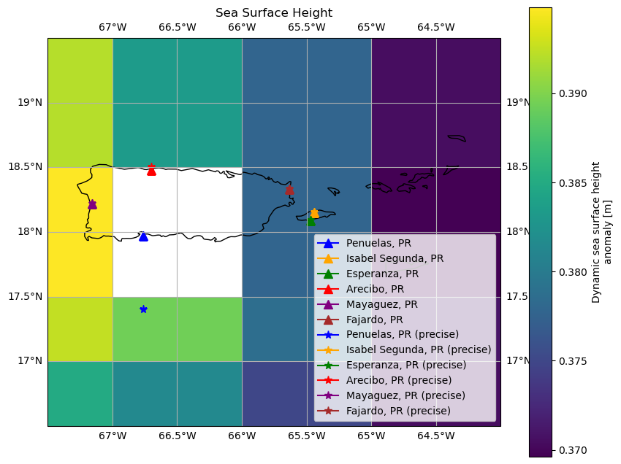
Hurricane Maria
Notes:
AYMAN

Slide 6
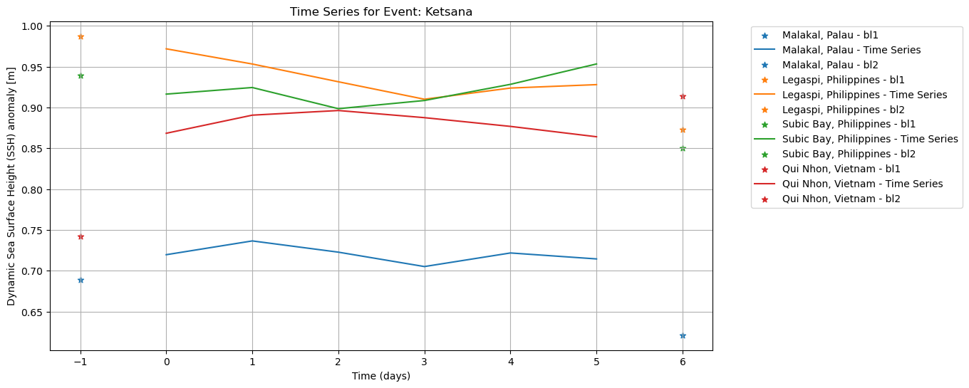
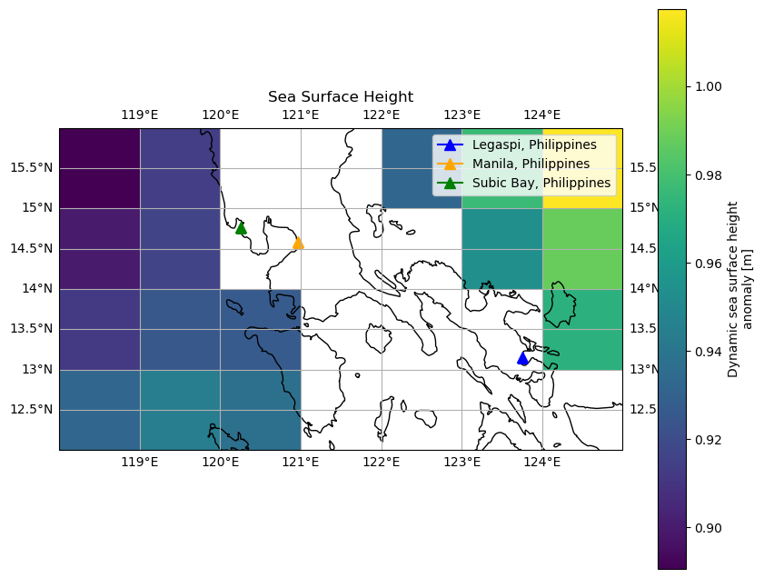
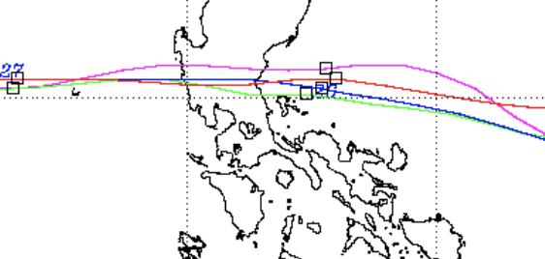
Typhoon Ketsana
Notes:
HANNAH

Slide 7
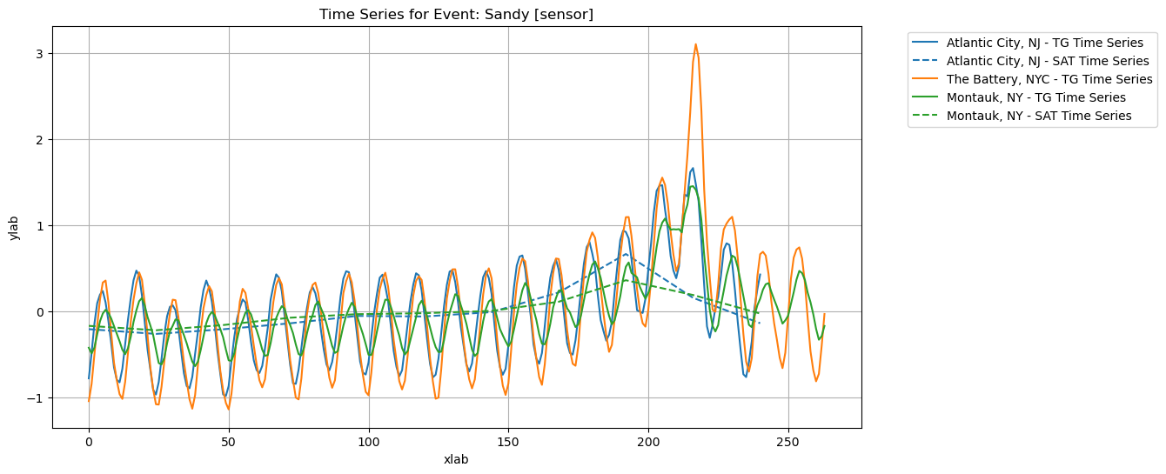
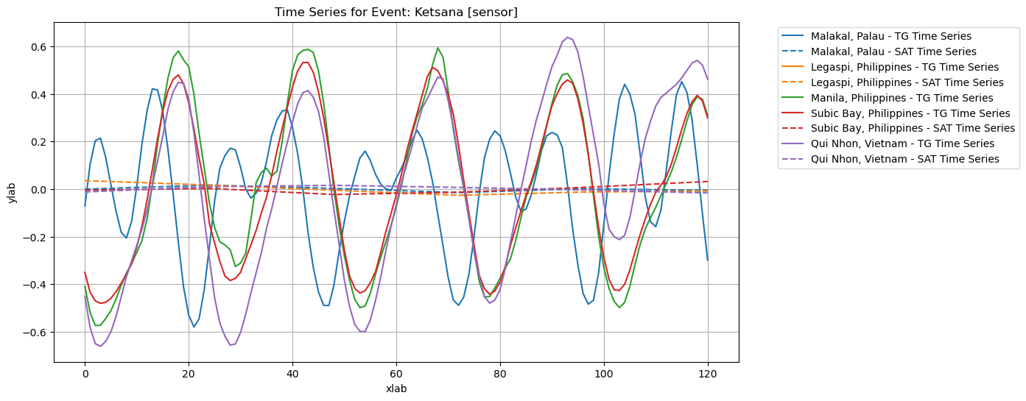
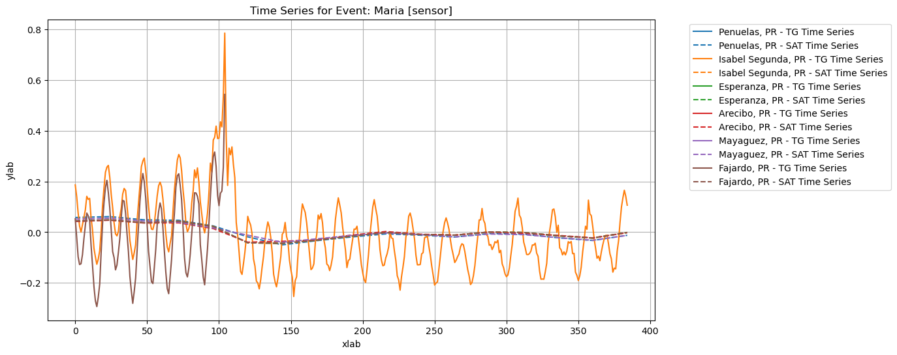
Normalized time series ECCO & TG
Notes:
HANNAH

Slide 8
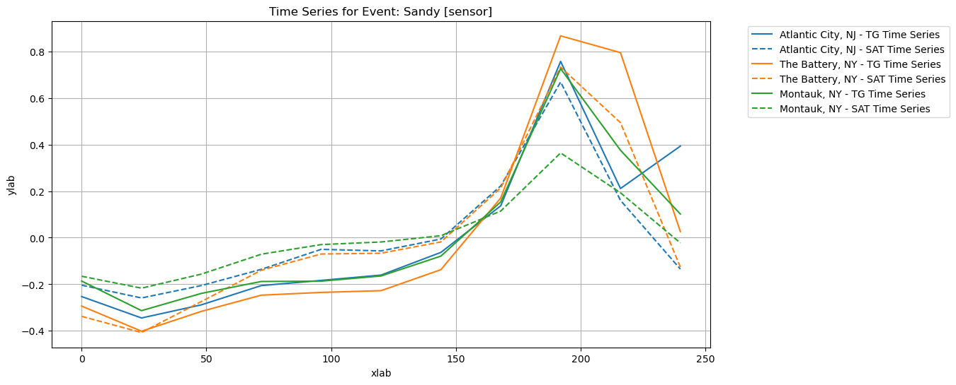
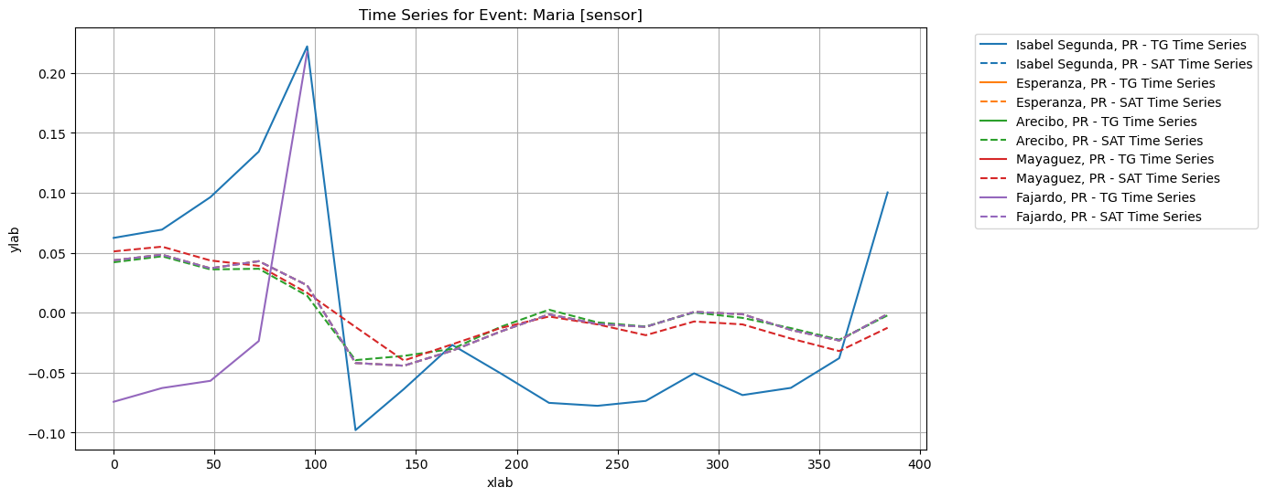
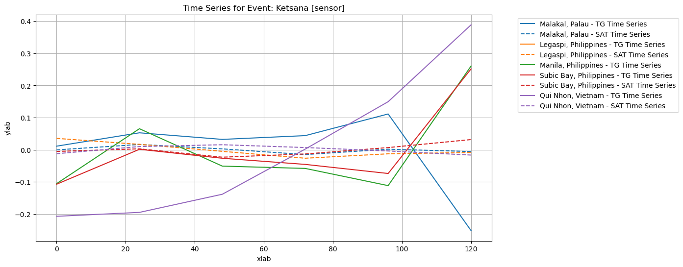
Normalized time series ECCO & TG (resampled)
Notes:
Franck

Slide 9
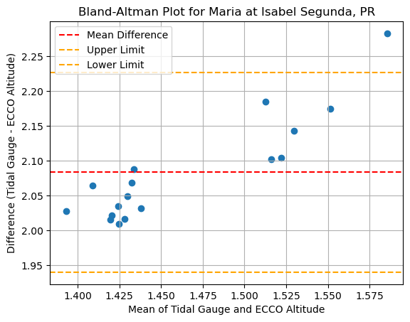
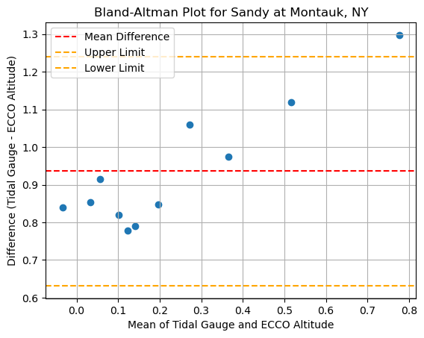
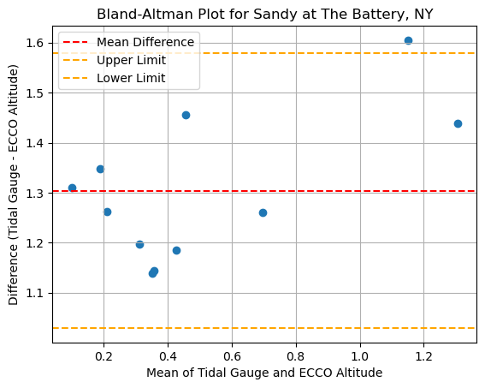
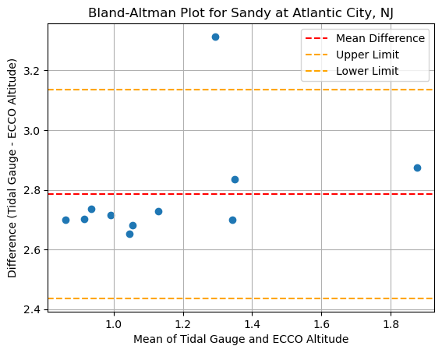
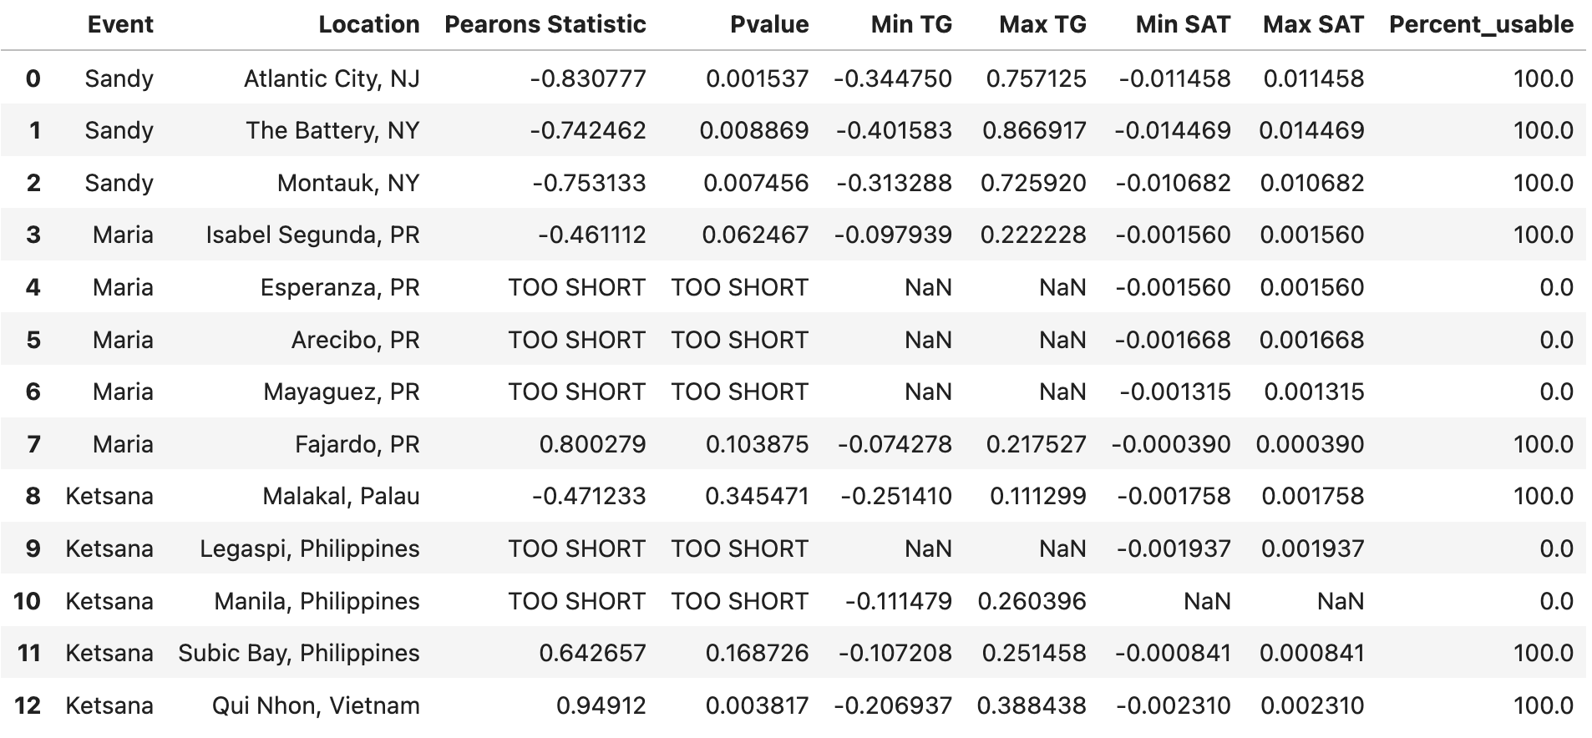
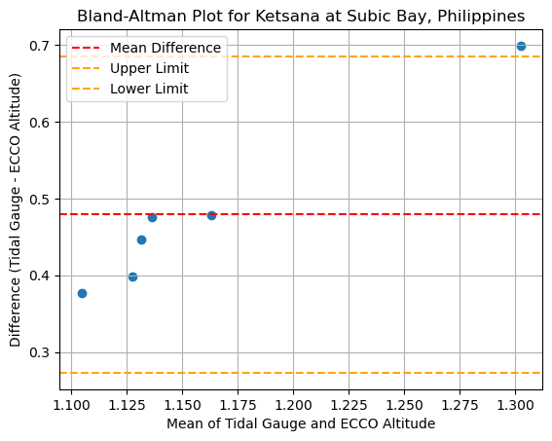
Correlation Analysis
Methods
Pearson correlation (assesses linear relationship)
Bland-Altman analysis for testing the agreement of two observation procedure
Notes:
FRANCK

Slide 10
Conclusions
The visualizations of the data resampled to the same time steps appear to show a linear relationship (e.g; TG data increases over the same time steps as the ECCO data from that same location). Statistical analysis of correlation values, however, do not agree. We think this is due to a methodological error in the analysis which we would hope to address with more time.
Bland-Altman analyses show that for higher sea level values, the level of disagreement between TG and ECCO data increases. This suggests that extreme events like storms contribute to greater differences in the measured values of sea level between data systems.
There are pros and cons to analyzing storm events with both data sources.
Tidal gauges
Benefit: Unmatched temporal resolution (as fine as just several minutes) can be especially useful for picking up small changes in RSL due to tides without any interpolation
Downfall: Major storms can damage tidal gauges and render them useless during important times
Satellite (ECCO)
Benefit: Not susceptible to damage in the middle of an event
Downfall: Cannot necessarily capture short time scales which take tides into account
Lots of room for future work
Due to limited project time, we were restricted to data we could quickly access
The ECCO data that we could access offers daily data
This means either coarsening or interpolation in required to fairly correlate tidal gauge with satellite data
More time could allow us to access satellite data at a finer temporal resolution
Notes:
JAMES: Future modeling projections that are needed for local SSH predictions, especially in comparison to local current, temperature changes, and salinity changes, and bottom drag.

Slide 11
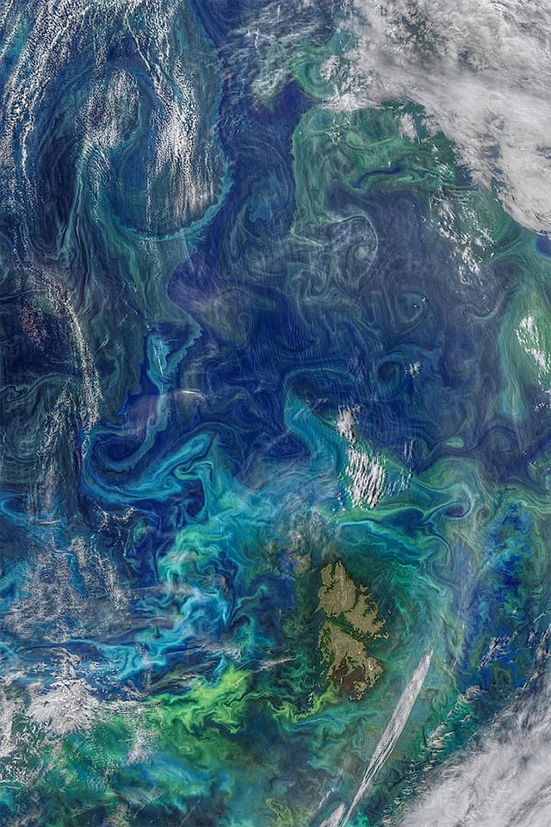
Additional Information (beyond the presentation)

Slide 12

ECCO
ECCO stands for "Estimating the Circulation and Climate of the Ocean." It is a project that uses satellite observations, in-water instruments, and computer models to create a detailed picture of the global ocean circulation. This information is used to study ocean currents, heat transport, and other aspects of ocean climate.

Slide 13
How does ECCO work?
ECCO uses a combination of data assimilation and modeling to create its estimates of ocean circulation. Data assimilation is the process of combining observations with model predictions to improve the accuracy of the model. ECCO uses data from a variety of sources, including satellite altimetry, ocean buoys, and Argo floats.
The models used in ECCO are complex computer programs that simulate the physical processes that govern ocean circulation. These models are run on supercomputers and can take weeks or months to complete a single run.

Slide 14
What are the benefits of ECCO?
ECCO provides a wealth of information about the global ocean circulation. This information is used to study a variety of oceanographic and climate phenomena, including:
The El Niño-Southern Oscillation (ENSO)
The Gulf Stream
The thermohaline circulation
Ocean acidification

Slide 15
What are the limitations of ECCO?
ECCO is a complex project and there are some limitations to its accuracy. One limitation is that ECCO relies on data from a variety of sources, and the quality of this data can vary. Another limitation is that ECCO's models are simplified representations of the real ocean, and they cannot capture all of the complexity of ocean circulation.

Slide 16
What are the limitations of ECCO?
ECCO is a complex project and there are some limitations to its accuracy. One limitation is that ECCO relies on data from a variety of sources, and the quality of this data can vary. Another limitation is that ECCO's models are simplified representations of the real ocean, and they cannot capture all of the complexity of ocean circulation.

Slide 17
Tide Gauge Data
Tide gauge data is a valuable source of information about sea level changes. This data can be used to track long-term trends in sea level, as well as to monitor short-term changes that may be caused by storms, earthquakes, or other events..
Tide gauge data is typically available in two formats:
Raw data: Raw data is the original data collected by the tide gauge. This data can be used to calculate the water level, as well as to identify any errors or anomalies in the data.
Processed data: Processed data is the raw data that has been cleaned and corrected for errors. This data is typically used for scientific analysis and modeling

Slide 18
Bibliography
Horsburgh, K. J., and C. Wilson. “Tide-Surge Interaction and Its Role in the Distribution of Surge Residuals in the North Sea.” Journal of Geophysical Research 112, no. C8 (August 3, 2007): C08003. https://doi.org/10.1029/2006JC004033.
Kemp, Andrew C., Timothy A. Shaw, and Christopher G. Piecuch. “The Importance of Non-Tidal Water-Level Variability for Reconstructing Holocene Relative Sea Level.” Quaternary Science Reviews 290 (August 2022): 107637. https://doi.org/10.1016/j.quascirev.2022.107637.
Muis, Sanne, Maialen Irazoqui Apecechea, Job Dullaart, Joao De Lima Rego, Kristine Skovgaard Madsen, Jian Su, Kun Yan, and Martin Verlaan. “A High-Resolution Global Dataset of Extreme Sea Levels, Tides, and Storm Surges, Including Future Projections.” Frontiers in Marine Science 7 (April 29, 2020): 263. https://doi.org/10.3389/fmars.2020.00263.
Widlansky, Matthew J., Xiaoyu Long, and Fabian Schloesser. “Increase in Sea Level Variability with Ocean Warming Associated with the Nonlinear Thermal Expansion of Seawater.” Communications Earth & Environment 1, no. 1 (August 20, 2020): 9. https://doi.org/10.1038/s43247-020-0008-8.
Woodworth, Philip L. “The Global Distribution of the M1 Ocean Tide.” Ocean Science 15, no. 2 (April 16, 2019): 431–42. https://doi.org/10.5194/os-15-431-2019.
Zlotnicki, Victor; Qu, Zheng; Willis, Joshua. 2019. SEA_SURFACE_HEIGHT_ALT_GRIDS_L4_2SATS_5DAY_6THDEG_V_JPL1609. Ver. 1812. PO.DAAC, CA, USA. Dataset accessed [July 24, 2023] at https://doi.org/10.5067/SLREF-CDRV2

